Slide 1
Azure Arc
Innovate anywhere with Azure
Kal Patel
Senior Cloud Solution Architect

Slide 2
Challenges and opportunities driving accelerated innovation
Manufacturers are facing disruptive changes
Retailers are adopting a digital first mindset
92%
83%
72%
Data
explosion
of manufacturers either piloting or scaling digital technologies to target cost reduction
currently seeing services business model as major opportunity area
consumers say only engaged in personalized marketing
More data generated in next
3 years than in the past 30
Ongoing healthcare system impacts
Next-generation technologies are pushing Finance
14M
$6.2B
54%
37%
By 2030, providers will suffer from a projected shortage of healthcare workers worldwide
Loss per year to data breaches,
amid growing pressures in security and compliance
of banks think removing friction from the customer journey is the most important trend in retail banking
of bank executives plan to upgrade their IT infrastructure to cut cost and improve efficiency

Slide 3
Customer aspirations
Deliver products as a service
Transform data into new products
Accelerate application development
Secure and govern distributed digital estate
Modernize facilities and assets

Slide 4

Azure 1
Security, operations, and governance
Azure services
Cloud infrastructure
Tools and experiences

Slide 5



Azure 3
Security, operations, and governance
Tools and experiences
Azure services
Azure Arc enabled services
Azure Arc
Cloud infrastructure
Azure Arc enabled infrastructure + devices
Innovate anywhere
Cloud regions
Regional edge
IT edge
IoT edge
50+ Azure regions
Multicloud
Operator DC
Co-Lo provider
Customer DC
Branch office
Factory floor
Retail store
Field production

Slide 6








Migrate and Modernize to Azure on your own terms
Azure Arc helps you consistently secure and govern infrastructure across hybrid environments as you migrate and modernize.
100 x On-Premises and/or multicloud Servers (Windows/Linux/SQL)
70 x Azure VMs
Servers that are ready to move to the cloud
Microsoft Defender for Cloud
Migrate to Azure
Turn on Azure security, monitoring and governance services for all servers no matter where you are in the migration journey
Microsoft Sentinel
30 Arc-enabled servers
Servers that are not ready to move to the cloud
Azure Policy
Onboard to Azure Arc
Azure Monitor

Slide 7




Innovate anywhere with Azure
Azure Arc
Develop
cloud native,
operate anywhere
Harness data
insights from
cloud to edge
Secure and
govern across environments
Flexibly meet
regulatory and connectivity needs

Slide 8
Innovate anywhere with Azure
Azure Arc
Develop
cloud native,
operate anywhere
Harness data
insights from
cloud to edge
Secure and
govern across environments
Flexibly meet
regulatory and connectivity needs

Slide 9


  Secure and govern across environments
Cloud-based threat detection
Dynamic visibility and compliance
Foster collaboration culture

Slide 10

product
Now available
Azure Arc-enabled servers
Microsoft Defender for Cloud
Microsoft Sentinel
Azure Policy
Azure Monitor
Azure Resource Manager
Microsoft Purview
Azure Automanage
Azure Update Management Center
Azure Arc-enabled VMware vSphere
Preview

Slide 11




Azure Arc-enabled servers
Bring Azure capabilities to your on-premises and multicloud servers with Azure Arc
GENERALLY AVAILABLE
Reach
Windows and Linux
VM and bare metal
At scale searchable inventory
Configure
Consistent VM extensions
Centralized agent management—Monitoring, Security, Update Management
Govern
Built-in Azure policies
Compliance across environments
Audit and enforce OS settings
Secure
Azure Active Directory
Managed Identity
Server security baselines
Role-Based Access control
Any infrastructure, familiar tools

Slide 12
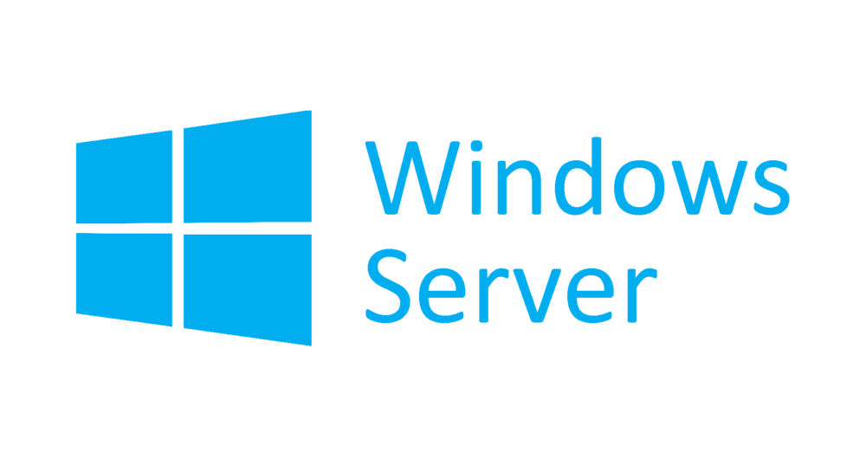


Azure Arc-enabled servers
Azure Arc-enabled servers are auto-enrolled with additional Azure services
Additional services
Azure Policy
Microsoft Defender for Cloud
Microsoft Sentinel
Azure Monitor
Change and inventory tracking
Update management
Azure Security Center
AWS Linux 2
Just turn them on when you want to use them

Slide 13
Azure Arc-enabled VMware vSphere
Provision and Manage VMware VMs from Azure using Azure Arc
PREVIEW
Virtual Machine Lifecycle
Perform full lifecycle management such as create, resize, and delete on VMware VMs from Azure
Self-Serve Operations
Use Azure RBAC to enable
teams and workload owners
to provision and manage VMs
on demand
Single Pane
View
Browse your VMware VMs from your data centers and AVS along with your Azure VMs
Discover and onboard existing VMware VMs to Azure
Azure Management services
Perform governance, monitoring, update management, security
at scale using rich Azure management services like
Azure Monitor, Security
Center and others
VMware vSphere environments hosted in your datacenter or on Azure VMware Solutions

Slide 14






Centralized identity and access control
Azure AD (RBAC)
Control and delegate access to Azure Arc-enabled resources from the Azure Portal with role-based access control (RBAC)
Use managed identities to access other Azure resources that support Azure AD-based authentication
Azure Arc
On-Premises and/or Multicloud
*Forrester Consulting, Total Economic Impact™ of Microsoft Microsoft Sentinel, 2020

Slide 15


Microsoft Defender for Cloud
Assess, secure, and defend your hybrid and multicloud workloads
Continuously assess. Understand your current security posture, identify and track vulnerabilities. Get a bird’s eye-view of your security posture with Secure Score
Secure. Harden connected resources and services by following customized and prioritized recommendations with Azure Security Benchmark
Defend. Detect and resolve threats to those resources and services. With prioritized security alerts, focus on what matters the most and surface to the right audience
SQL/Storage
VMs
Containers
Network
Industrial
IoT
Apps
Microsoft Defender for Cloud
Multi-cloud
Datacenter
Edge

Slide 16
Deploy Defender for Servers anywhere
Easily deploy as extensions in Azure without
re-installing agents
Vulnerability assessment built-in with flexibility to
use tools like Qualys offering integrated vulnerability scanning for your connected machines
Use Just-in-Time VM access to control access to commonly attacked management ports
Block malware with adaptive application controls
Set guardrails with Azure Policy integration, server owners can view and remediate to meet their compliance
Microsoft Defender for Servers
Azure Arc
On-premises and/or multi-cloud
Azure Arc-enabled servers

Slide 17

Deploy Defender for databases (SQL) anywhere
Monitor and remediate potential vulnerabilities for SQL Servers in Azure, on-premises or in other clouds
Discover, track, and remediate potential database vulnerabilities with assessment scans.
Monitor for threats such as SQL injection, brute-
force attacks, and privilege abuse with advanced
threat protections
Microsoft Defender for SQL
Azure Arc
On-premises and/or multi-cloud
Azure Arc-enabled SQL Server

Slide 18
Microsoft Defender for Cloud on SQL Server
Continuously assess, secures, and hardens your hybrid and multi-cloud SQL server estate against vulnerabilities and threats
Allows to deploy Defender at scale to your Arc- enabled SQL Server estate
Remediate potential vulnerabilities with point and click fixes or detailed guidance
Incident management and threat intelligence through Microsoft Sentinel
Microsoft Defender for SQL
Recommendations
Security Alerts
Workload protection
Secure score
Azure Arc
On-premises and/or multi-cloud
Azure Arc-enabled SQL Server

Slide 19

Deploy Defender for Containers anywhere
Single pane of glass for Kubernetes security—including multi-cloud clusters
Environment hardening—Defender for Containers protects Arc-enabled Kubernetes clusters by providing visibility into misconfiguration and guidelines to help mitigate identified threats
Microsoft Defender for Containers
Azure Arc
On-premises and/or multi-cloud
Azure Arc-enabled Kubernetes clusters

Slide 20





Continuous assessment and Security posture management
EVALUATED CATEGORIES
Gain insights into the security state of your cloud workloads across Azure, AWS, and GCP
Address security vulnerabilities with
prioritized recommendations
Improve your secure score and overall
security posture in minutes
Speed up regulatory compliance
Granular control of secure score
Access
Compute
SQL server
Network
App
+7%
+2%
+1%
+3%
+2%
SECURE SCORE IMPACT
50%
Secure
score

Slide 21
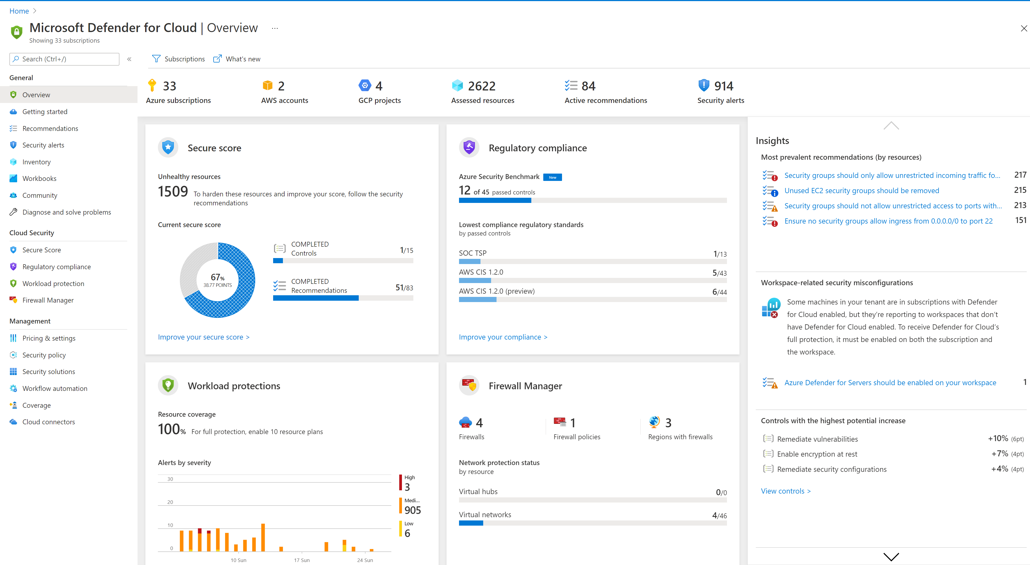
Secure with tailored recommendations
Unified resource view
All your cloud resources in one place: Azure, AWS, on-premises, and other clouds
Focused views for security posture, compliance, and workload protection
Clear & simple view
Identify all your security
related stats at a glance
Emphasis on visibility & clear KPIs

Slide 22
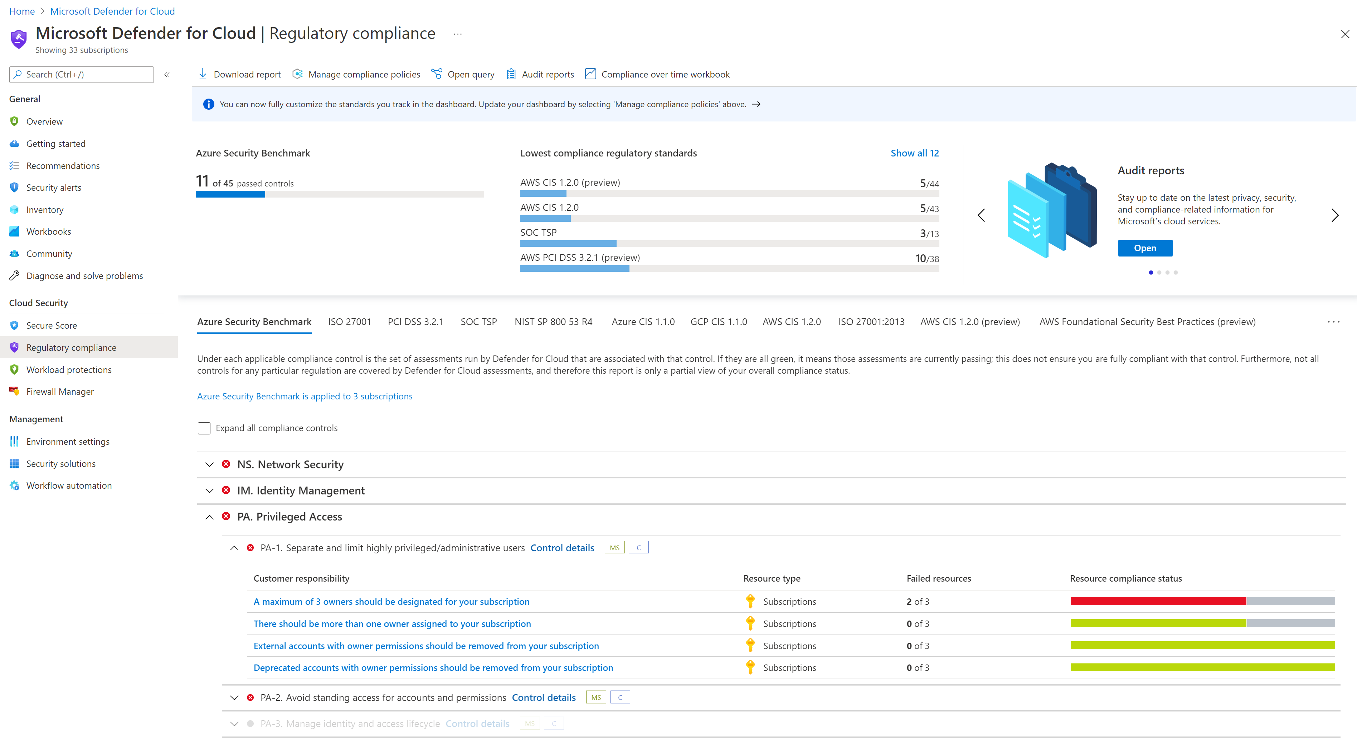
Compliance assessment and governance
Demonstrate compliance status, based on continuous assessments of your Azure and AWS resources
Azure Security Benchmark monitoring enabled by default
Mapped to the MITRE ATT&CK® framework
Support for common industry and regulatory standards, as well as custom requirements
Overview and reports of your compliance status

Slide 23
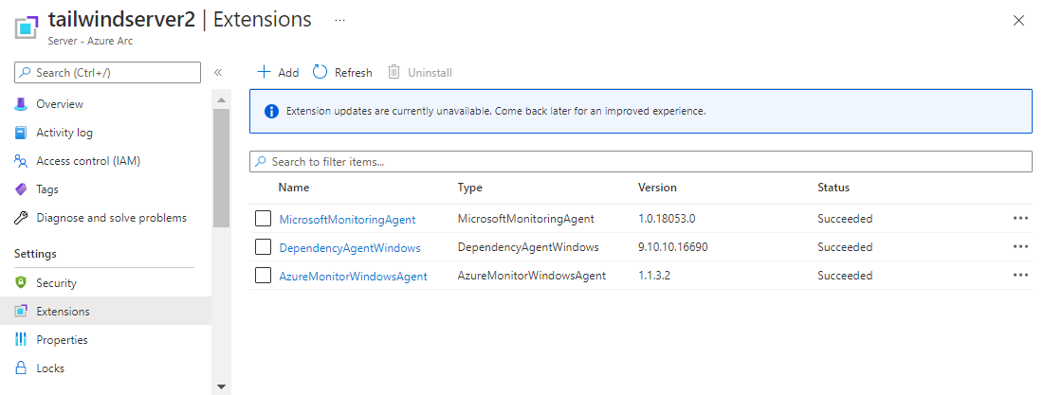
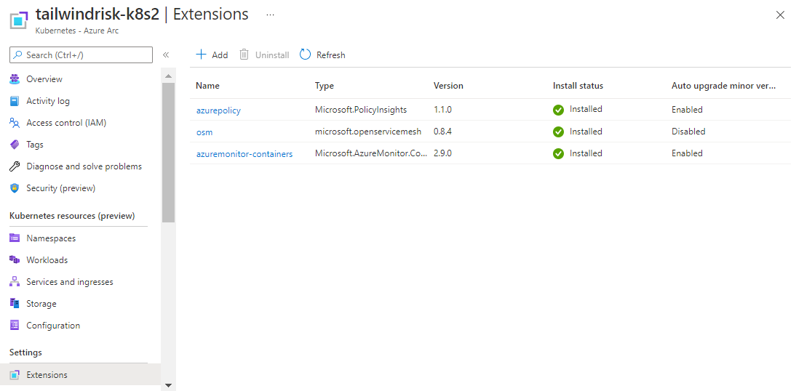
Deploy Azure Monitor seamlessly
Use VM and Cluster Extensions to easily deploy to Servers and Kubernetes anywhere
Azure Monitor
Delivered as VM Extension on Servers
Delivered as Cluster Extension on Kubernetes
Azure Arc
On-Premises and/or Multicloud
Azure Arc-enabled servers
Azure Arc-enabled Kubernetes clusters

Slide 24
Microsoft Sentinel
Intelligent, scalable, and cloud native SIEM and SOAR solution.
Microsoft Sentinel
Collect data at cloud scale—across all users, devices, applications, and infrastructure, both on-premises and in multiple clouds
Detect previously uncovered threats and minimize false positives using analytics and threat intelligence from Microsoft
Azure Arc
Investigate threats with AI and hunt suspicious activities at scale, tapping into decades of cybersecurity work at Microsoft
On-Premises and/or Multicloud
Respond to incidents rapidly with built-in orchestration and automation of common tasks

Slide 25











Azure Arc-enabled servers
Connectivity Options
Direct connection (Internet)
Connection via Proxy (Internet)
Service tag (S2S VPN/ER)
Private Link (S2S VPN/ER)
Azure Arc Service Endpoint
Public Endpoint
Private Endpoint
Internet
Azure Arc enabled Server
Service tag
Private Link
Proxy
Azure Express Route &
Site-to-Site VPN
Azure VNET

Slide 26
















Azure Arc-enabled servers
VM extension integration
Azure Arc-enabled servers with VM extensions
VM extensions
Azure Monitor
Azure Automation
Custom Script
Azure Arc-enabled servers
onboarding Interfaces
Microsoft Defender for Cloud
Azure Key Vault
Azure Log Analytics
Azure portal
Azure REST API
Azure CLI
PowerShell
Windows Admin Center
Azure Automanage
Multicloud & On-Premises servers
Azure Arc-enabled servers onboarding

Slide 27


Azure Arc-enabled servers
SSH access - Architecture
Azure Resource Manager
Resource Provider
GNS
Client/Caller
application
Proxy
Agent
Local Service
Azure Relay service
Managed Service Identity (MSI)

Slide 28

Azure hybrid data manageability for SQL Server
Manage, govern, and protect your SQL Server from Azure
Manage all your SQL estate using Azure
Control and govern your entire data estate
Protect all your data using Azure security
Single view of all SQL Servers deployed on-premises, in Azure and other cloud
Fully automated technical assessment for SQL Server – no additional cost
Central insights and governance across all SQL Servers with Microsoft Purview
Purview access policies readily available for SQL Servers on-premises
Protect your on-premises data using Microsoft Defender for Cloud
Secure identities with Single Sign-On and Azure Active Directory*
Easy connection enabled by Azure Arc for existing SQL Servers without migration
*SQL Server 2022 required for Azure Active Directory. All other features supported on SQL Server 2012, 2014, 2016, 2017, and 2019.

Slide 29
Innovate anywhere with Azure
Azure Arc
Develop
cloud native,
operate anywhere
Harness data
insights from
cloud to edge
Secure and
govern across environments
Flexibly meet
regulatory and connectivity needs

Slide 30

Develop cloud-native, operate anywhere
Build and modernize to cloud-native apps on any Kubernetes
Bring cloud data management to any infrastructure
Consistent GitOps and policy driven deployment and configuration across environments
Integrate Azure Security, governance and monitoring into your DevOps toolkit

Slide 31
Product page
Updated
Now available
At-scale Kubernetes management
GitOps pipelines
Azure monitoring and security for containers
Open Service Mesh
Azure application services
Azure Kubernetes Service (AKS) enabled by Azure Arc
Azure Hybrid Benefit for AKS
Run AKS on Windows Server & Azure Stack HCI at no additional cost for Windows Server SA or CSP subscription customers
Azure Policy offer
Available for 1 year for Arc-enabled Kubernetes
at no additional charge
Preview
Preview

Slide 32





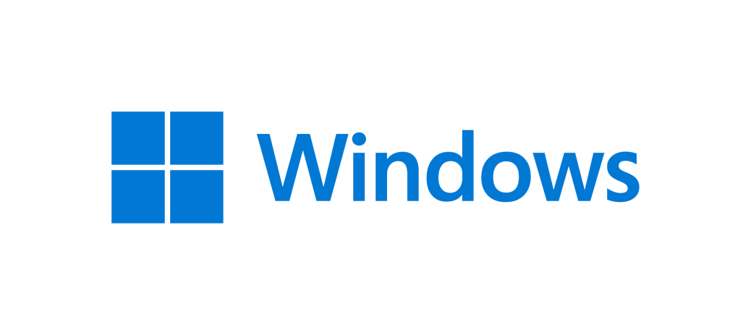

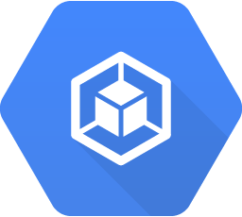

Managed Kubernetes from cloud to edge
Flexible deployment options on the infrastructure of your choice
GENERALLY AVAILABLE
AKS
3P Kubernetes
Kubernetes
OpenShift
EKS
VMware Tanzu
GKE
Azure
Windows Server & Azure Stack HCI
Windows IoT devices
Any CNCF K8s
Consistent Developer tools
Azure Arc

Slide 33





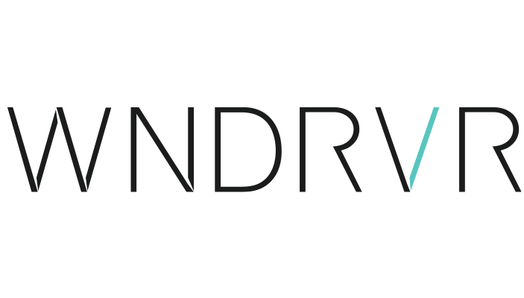



Azure Arc-enabled Kubernetes
Connect, manage, and operate Kubernetes clusters and applications running anywhere using Azure Arc
GENERALLY AVAILABLE
AKS on Azure Stack HCI or Windows Server
Multiple 3P Kubernetes flavors supported
Deploy apps and configurations at-scale with GitOps
Secure, govern, and monitor all your clusters, from Azure
AKS
Kubernetes
OpenShift
EKS
GKE
VMware Tanzu

Slide 34

Azure Arc-enabled Kubernetes features
Easily integrate with Azure services using Cluster Extensions
Monitor
Secure
Collect metrics and logs of application workloads
Open ecosystem
Multi-cluster roll-up and cluster
drill down views
Microsoft Defender for Cloud Integration
Threat detection across on-premises and multicloud
Actionable recommendations for security best practices

Slide 35


Azure Arc-enabled Kubernetes features
Provide Azure services and users secure access to Arc-enabled Kubernetes clusters
AAD RBAC
Cluster Connect
Custom Locations
Role assignments in Azure to control authorization checks in cluster
Cluster scope and
namespace scope support
Custom roles support
No inbound ports needed on firewall
Interactive developer debugging from anywhere
Deploy using GitHub Actions and Azure DevOps Pipelines hosted agents
Deploy Azure PaaS services
to any location

Slide 36
GitOps – Definition & Principles
Git as the source of truth for a system
Git as the single place where we operate
(create, change, and delete)
All changes are observable
System state described declaratively
State declaration versioned in source control
Approved changes are applied automatically
Agents enforce desired state
https://www.weave.works/technologies/gitops/

Slide 37
Innovate anywhere with Azure
Azure Arc
Develop
cloud native,
operate anywhere
Harness data
insights from
cloud to edge
Secure and
govern across environments
Flexibly meet
regulatory and connectivity needs

Slide 38



  Harness data insights from edge to cloud
Accelerate innovation via cloud data and AI
Improve operational efficiency
Reduce risk exposure

Slide 39
Product page
Now available
Azure Arc-enabled SQL Managed Instance
Azure Arc-enabled SQL Server
Connected and disconnected scenarios
Azure Machine Learning
Arc ESUs for SQL Server 2008/2012
Azure Arc-enabled PostgreSQL
Preview

Slide 40


Azure Arc-enabled data services
Existing apps
App modernization
Azure Arc-enabled
SQL Server
Azure Arc-enabled SQL Managed Instance
Azure Arc-enabled PostgreSQL
Organize, inventory
Enhanced security with Microsoft Defender for Cloud
Free SQL Assessment service
Azure SQL Managed Instance
on any infrastructure
Fully automated, evergreen SQL
Cloud billing model for on-premises
Azure Database for PostgreSQL
on any infrastructure
Fully automated, single server
Scale up/down/out/in
GENERALLY AVAILABLE
GENERALLY AVAILABLE
PUBLIC PREVIEW

Slide 41

Making the decision based on customer needs
Operational data workloads
Can data go to Azure?
Outside of Azure
No (Hybrid)
Yes (Full migration)
App modernization
Existing apps
Retire data centers
Limitless scale, E2E security
IaaS, PaaS, Single DB, Pools
Fully managed with SLAs
Access to the latest cutting-edge technology
Standardize data management with
agility and consistency
Reduce cost with full automation
Maintain server-based legacy applications
Reuse existing data center and SQL Server
Manage all SQL Server from one place
Azure SQL / OSS
databases
Azure Arc-enabled SQL Server
Any Kubernetes Cluster
Any Windows/Linux servers

Slide 42



Azure Arc-enabled data services | App Modernization
Bring cloud data management to any infrastructure
Supports all connectivity modes
Always up to date
Multi-layer security
Elastic scale
Simplified DevOps
Automated updates
No downtime, evergreen
Comprehensive encryption
Azure RBAC & Policy
Scale up and down
Pay for what you use
Deploy in seconds
Built in HA/DR
Any infrastructure

Slide 43
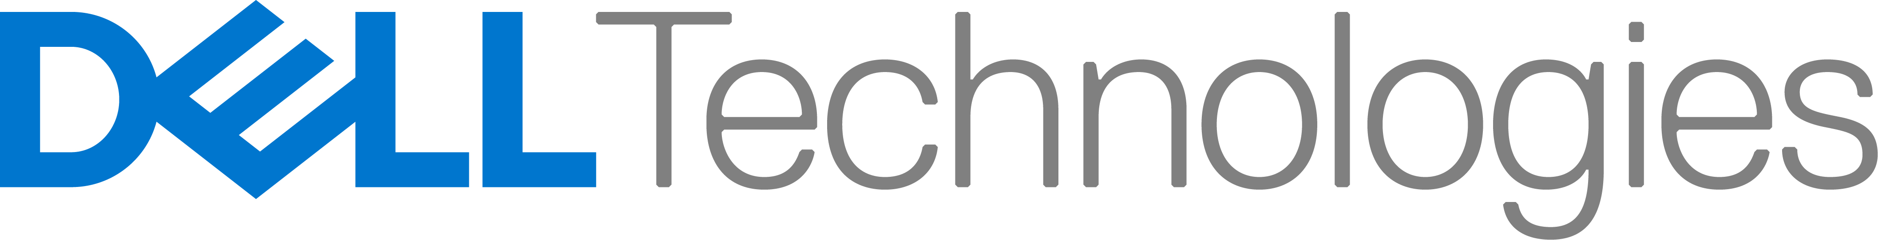
Build and run with confidence
Performance benchmarking using Business Critical tier of Arc-enabled SQL MI
15% faster
60 sec deploy
SQL Server 2019 EE
Arc-enabled SQL MI BC
2 mins HA
Dell PowerEdge Server 15g with PowerStore
Azure Arc-enabled SQL Managed Instance Business Critical with built-in 3-replica HA
SQL Server 2019 Enterprise Edition with Always-On Availability Group

Slide 44
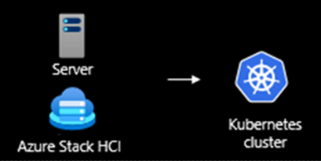




Machine learning anywhere
Azure Machine Learning
Build
Train
Validate
Deploy
Monitor
CI/CD and retraining
Kubernetes clusters
Azure ML Kubernetes Extension
Server
Azure Arc
Kubernetes
Cluster
Azure Arc
Kubernetes
Cluster
Azure Kubernetes Service
Azure Stack HCI
On-premises
Multi-cloud

Slide 45
Security Details
Features | Arc-enabled SQL Server | Arc-enabled SQL Managed Instance
Transparent data encryption (TDE) | Yes, customer managed key. No AKV integration yet. | Yes, customer managed key. No AKV integration yet.
Always Encrypted | Yes, with enclave support. | Yes, no enclave support yet.
Backup Encryption | Yes | Yes
SSL/TLS | Yes, TLS 1.2 | Yes, TLS 1.2. Automated cert rotation.
All in-database security features (Row-level security, Auditing, Dynamic Data Masking, RBAC) | Yes | Yes
Microsoft Defender for SQL Server | Yes (optional) | Not supported yet.
AD/Azure AD/SQL Login authentication | AD: Yes, AAD: Yes, SQL Server 2022 only, SQL Login: Yes | AD: Yes, AAD: Not supported yet. SQL Login: Yes
Requires Direct Connectivity to Azure | Yes, required. Proxy can be used for connectivity. | Optional. In Indirect Mode, billing data must be exported/uploaded to Azure 1/month and functionality is diminished.
Data sent to Azure | Basic instance information. All detailed information goes to customer-owned Log Analytics workspace (optional).

Slide 46
Innovate anywhere with Azure
Azure Arc
Develop
cloud native,
operate anywhere
Harness data
insights from
cloud to edge
Secure and
govern across environments
Flexibly meet
regulatory and connectivity needs

Slide 47



  Flexibly meet regulatory and connectivity needs
Meet data residency and sovereignty requirements
Simplified infrastructure for low-latency applications
Operate fully or intermittently
connected

Slide 48
Product page
Now available
Azure Stack HCI
Ultra low-latency 5G with Private MEC
Azure public MEC
Azure Stack HCI preview features:
GPU-P support
Azure Migrate Hyper-V to Azure Stack HCI
Virtual Guest Arc-enablement, extensions, ARM templates, Marketplace integration
Preview

Slide 49
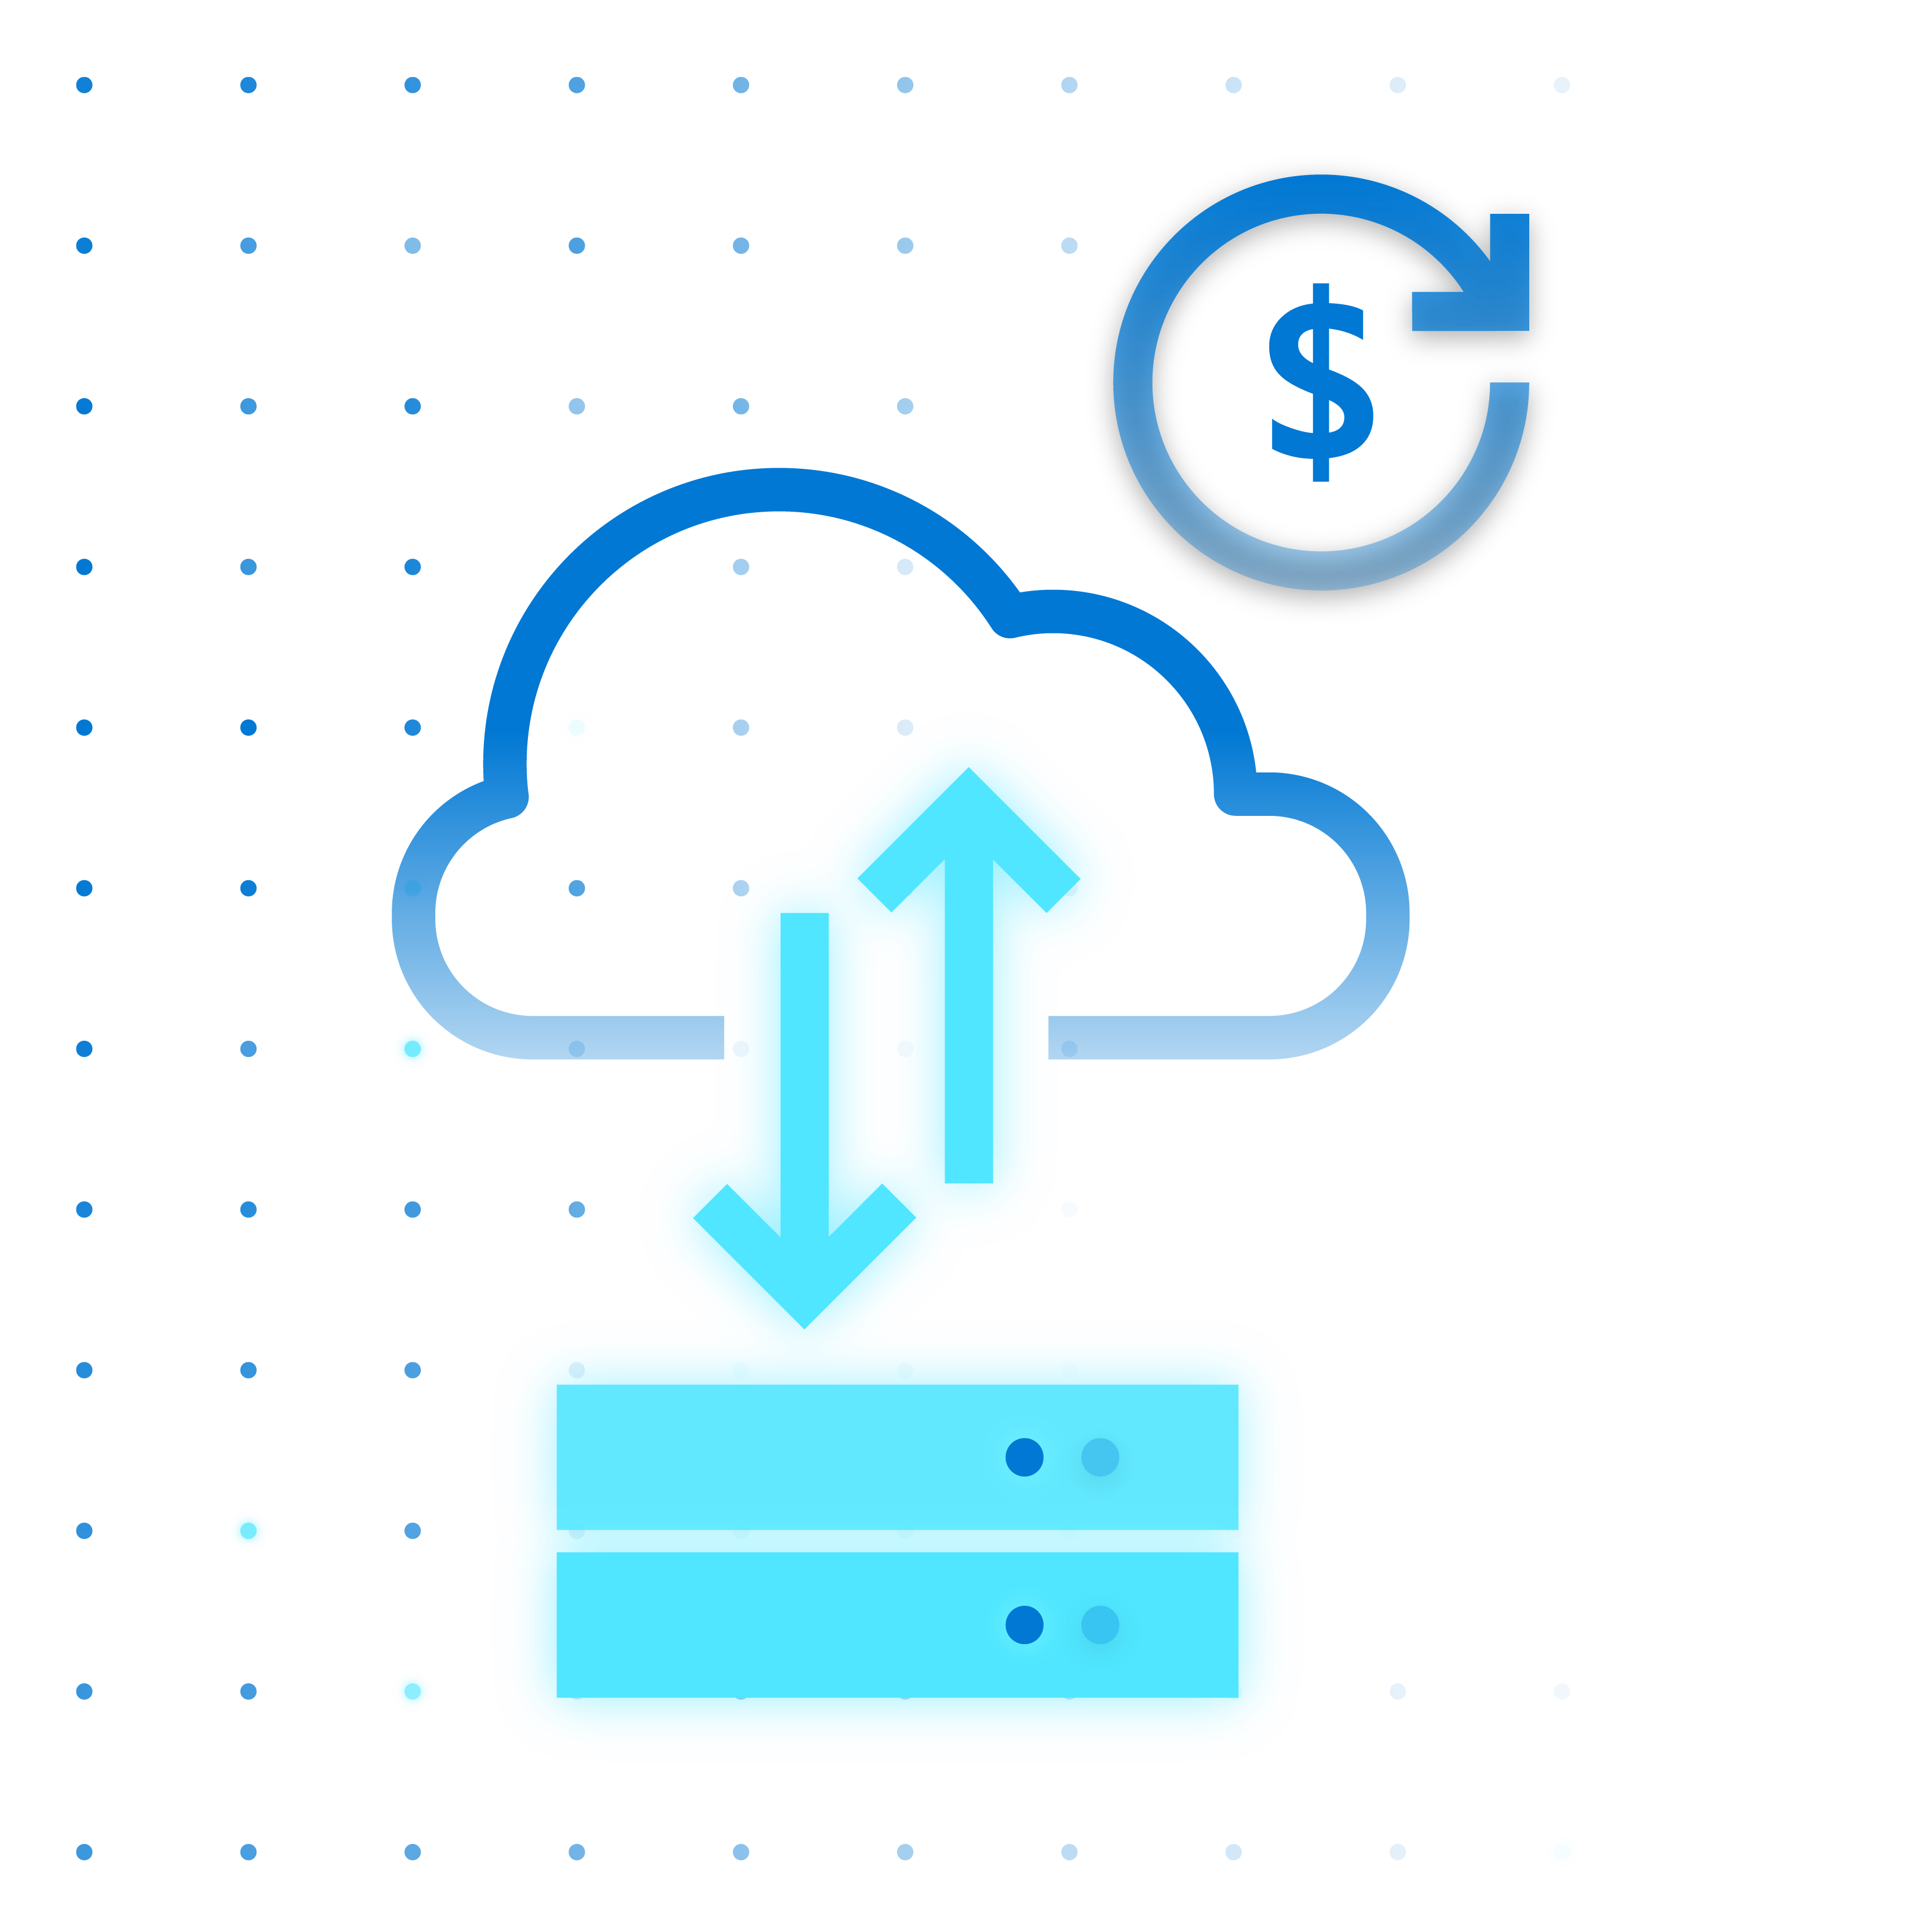
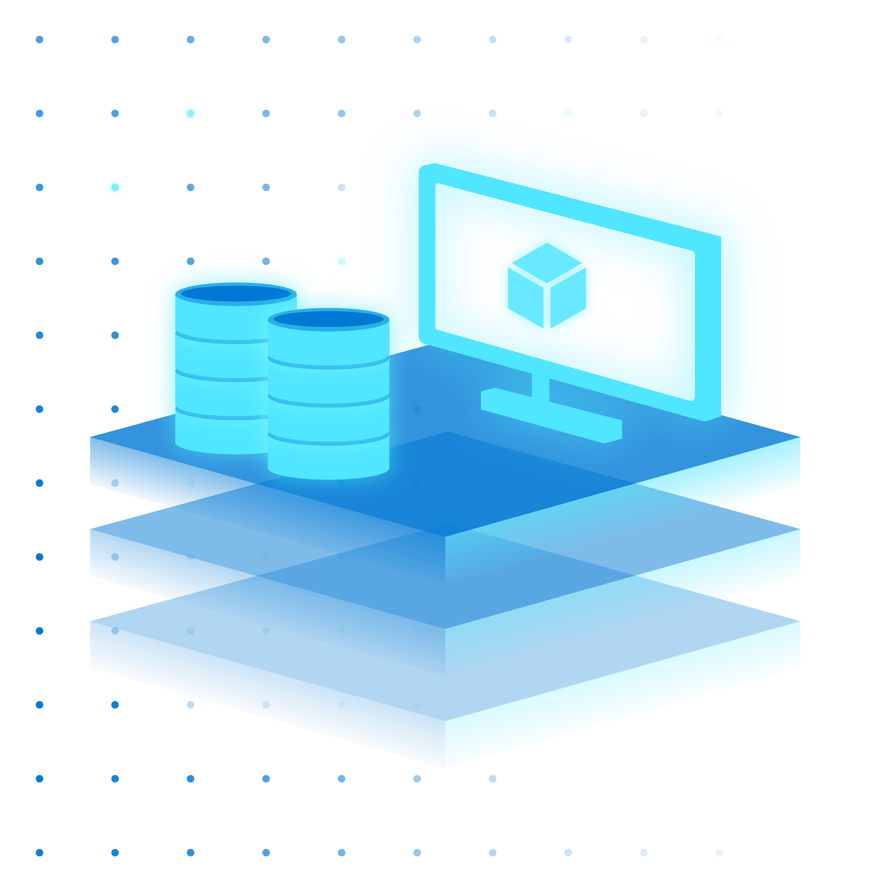


Azure Stack HCI
Modern subscription for flexible, familiar hyperconverged infrastructure
Azure hybrid
by design
Enterprise scale and price performance
Familiar management
and operations
Choice of deployment options

Slide 50


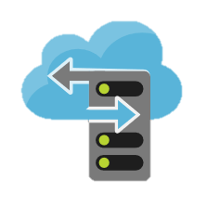



Connect seamlessly with Azure when using Windows Admin Center
Azure Site Recovery
Azure Backup
Azure File Sync
Azure Update Management
Azure Monitor
Microsoft Defender for Cloud

Slide 51


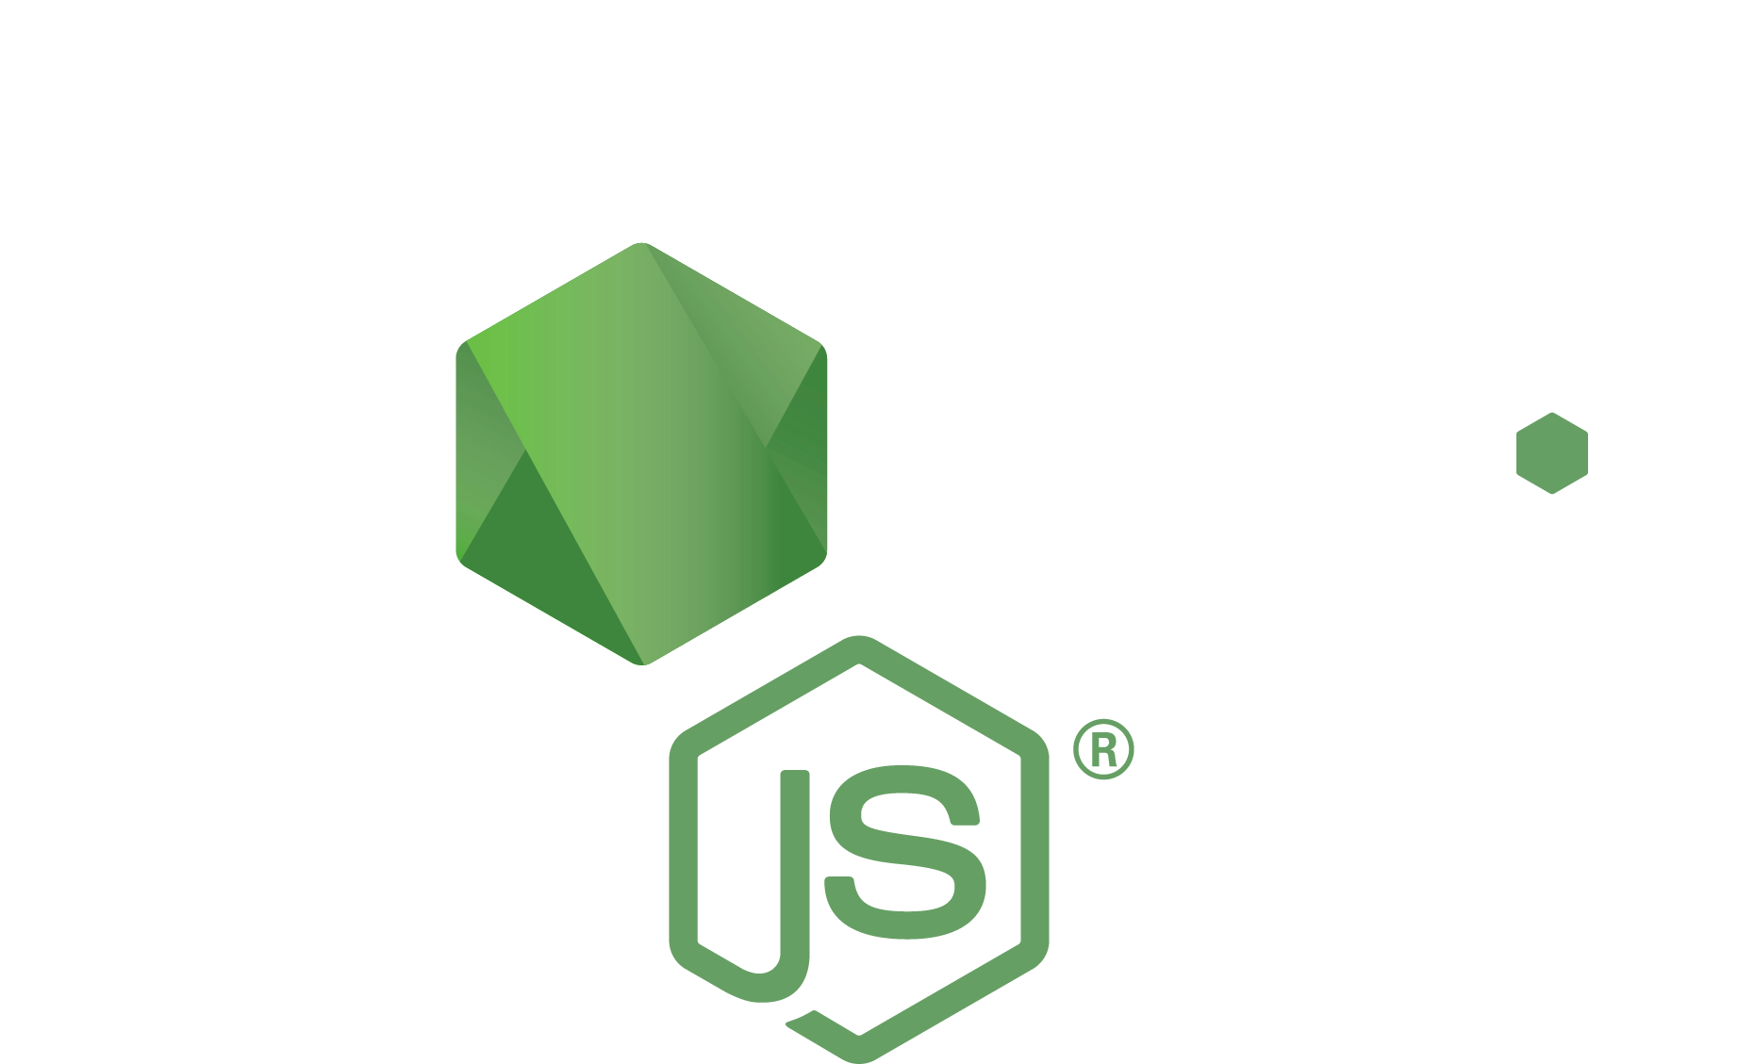


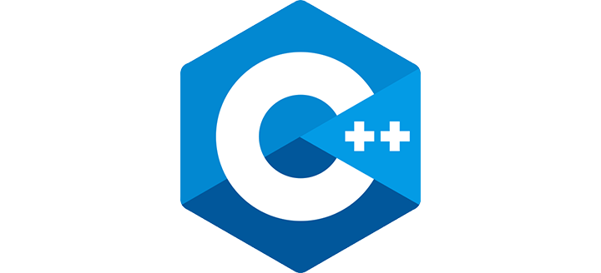




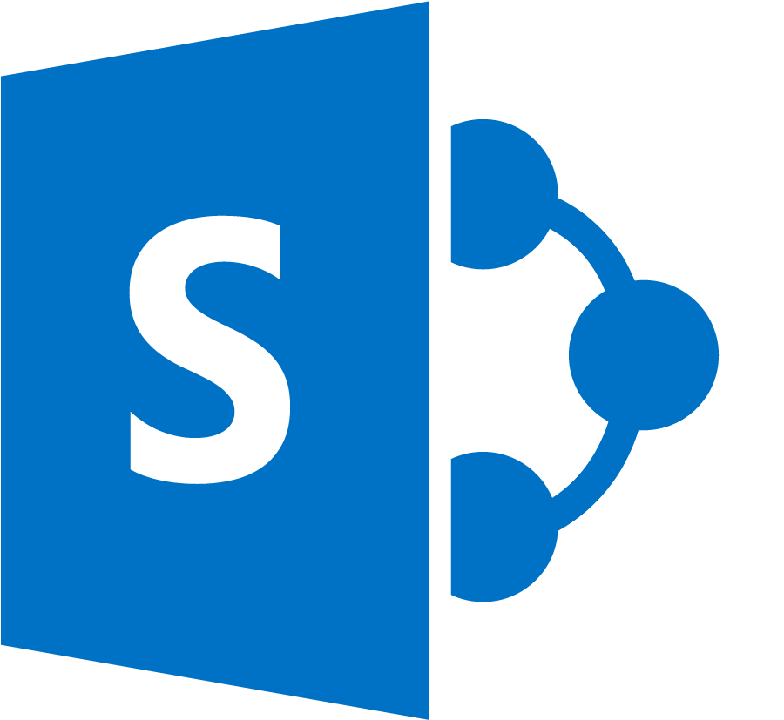





Azure Arc and Azure Stack HCI
Platform architecture
Cloud-Native
Applications
Azure
Arc
Virtual Machines
Applications
Containers
Azure Arc-enabled data services
Windows/Linux VMs
AKS enabled by Azure Arc
Azure Stack HCI operating system
Hardware ecosystem

Slide 52
Security
Azure Arc-enabled Azure Stack HCI and AKS

Slide 53


Layered security built-in
Industry leading built-in security
Microsoft’s security products are industry leading in several Gartner magic quadrants
Security built for the
Azure datacenter
Azure Stack HCI security derives learnings from our hyperscale cloud and brings it to your datacenter ​
Silicon assisted security
Unique differentiation delivered with our Silicon and OEM partners via Secured-core
Microsoft Defender
Servers, SQL, Domain controllers, VDI, Containers, Kubernetes
Securely operate your workloads
Simplified operational hardening
Confidential
Compute
TVM*, CVM*
Privileged Access
JIT, JEA, PIM, PAM, CG
Network Security
SDN, Datacenter
Firewall Secure DNS
Trustworthy addition to your environment
Encryption and
Data Protection
SMB, BitLocker,
Self-encrypting drives
System Security & Zero trust
Hardened defaults, Trusted Boot, Certificates,
Cryptography, Code Signing and Integrity,
Device Attestation, Zero trust
Silicon
assisted security
Hardware Root-of-Trust
TPM 2.0,Microsoft Pluton
Security processor*
Secured-core
Firmware, DMA, Memory,
Secured Kernel
Enable regulated customers
Security Assurance
Certification
Secure Supply Chain

Slide 54
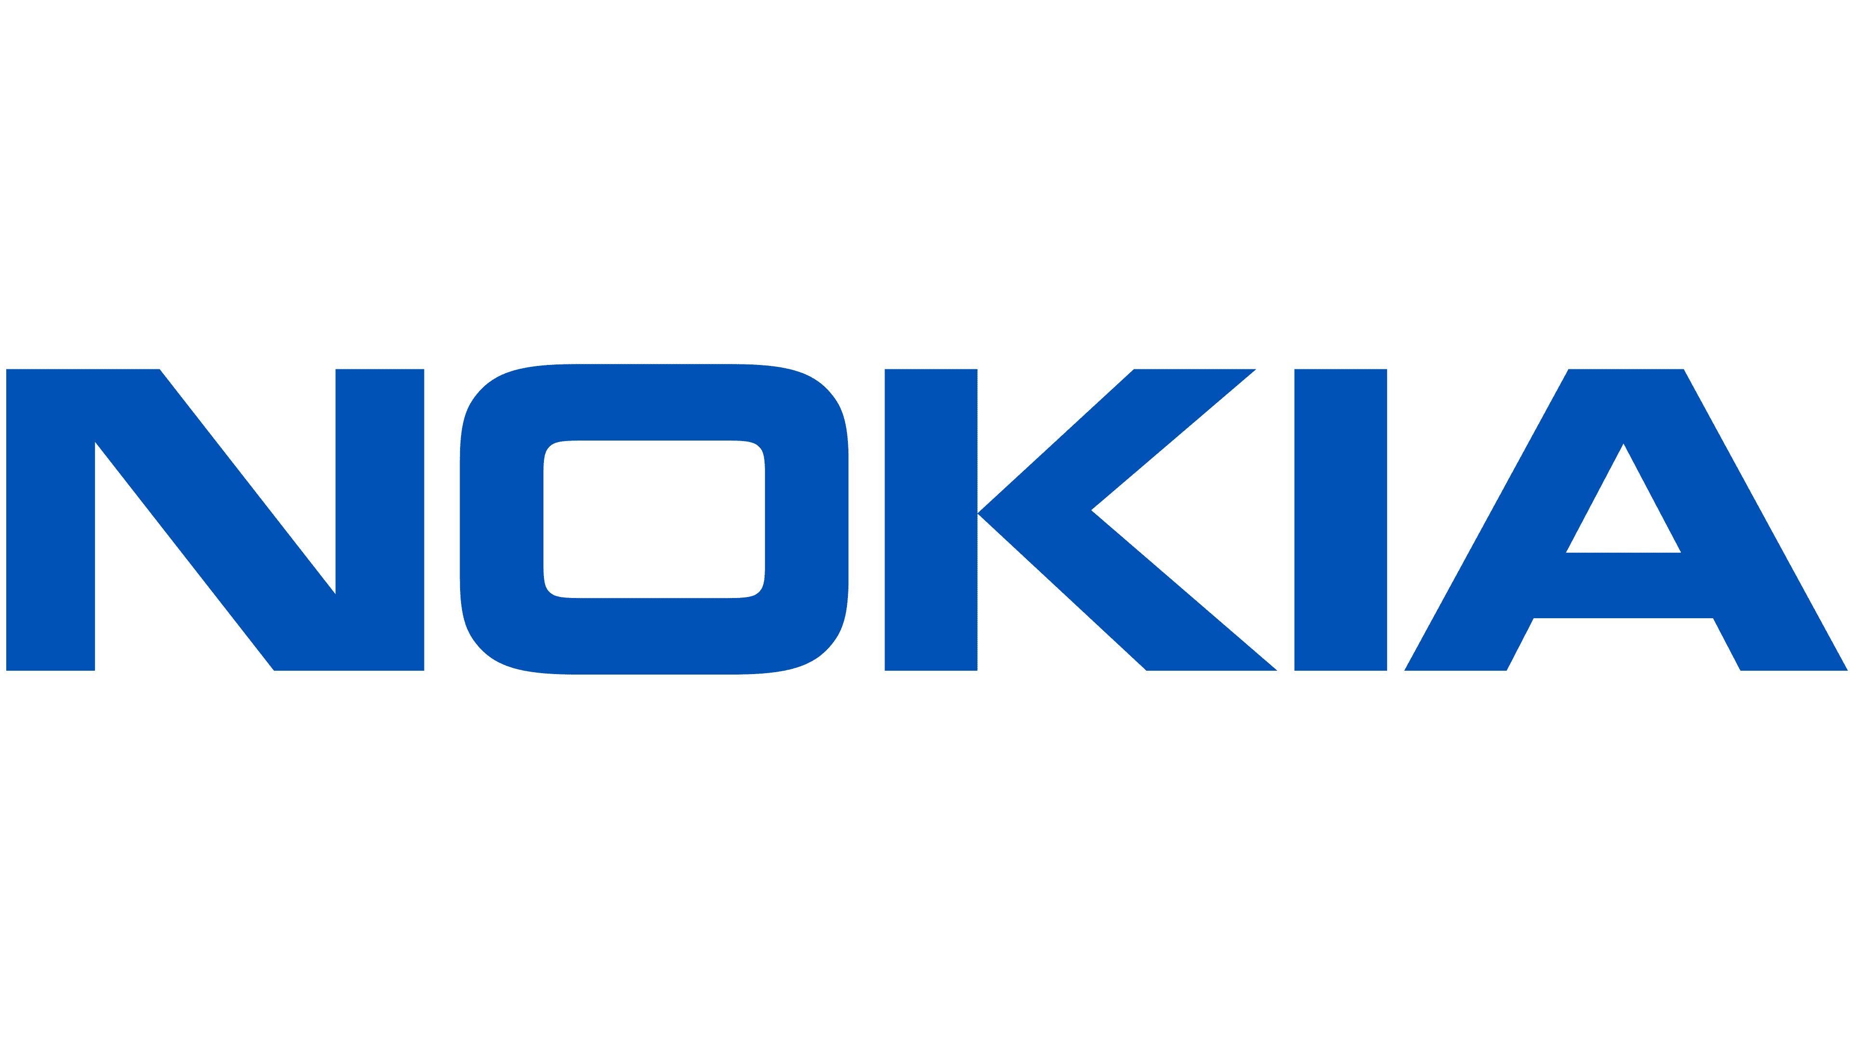
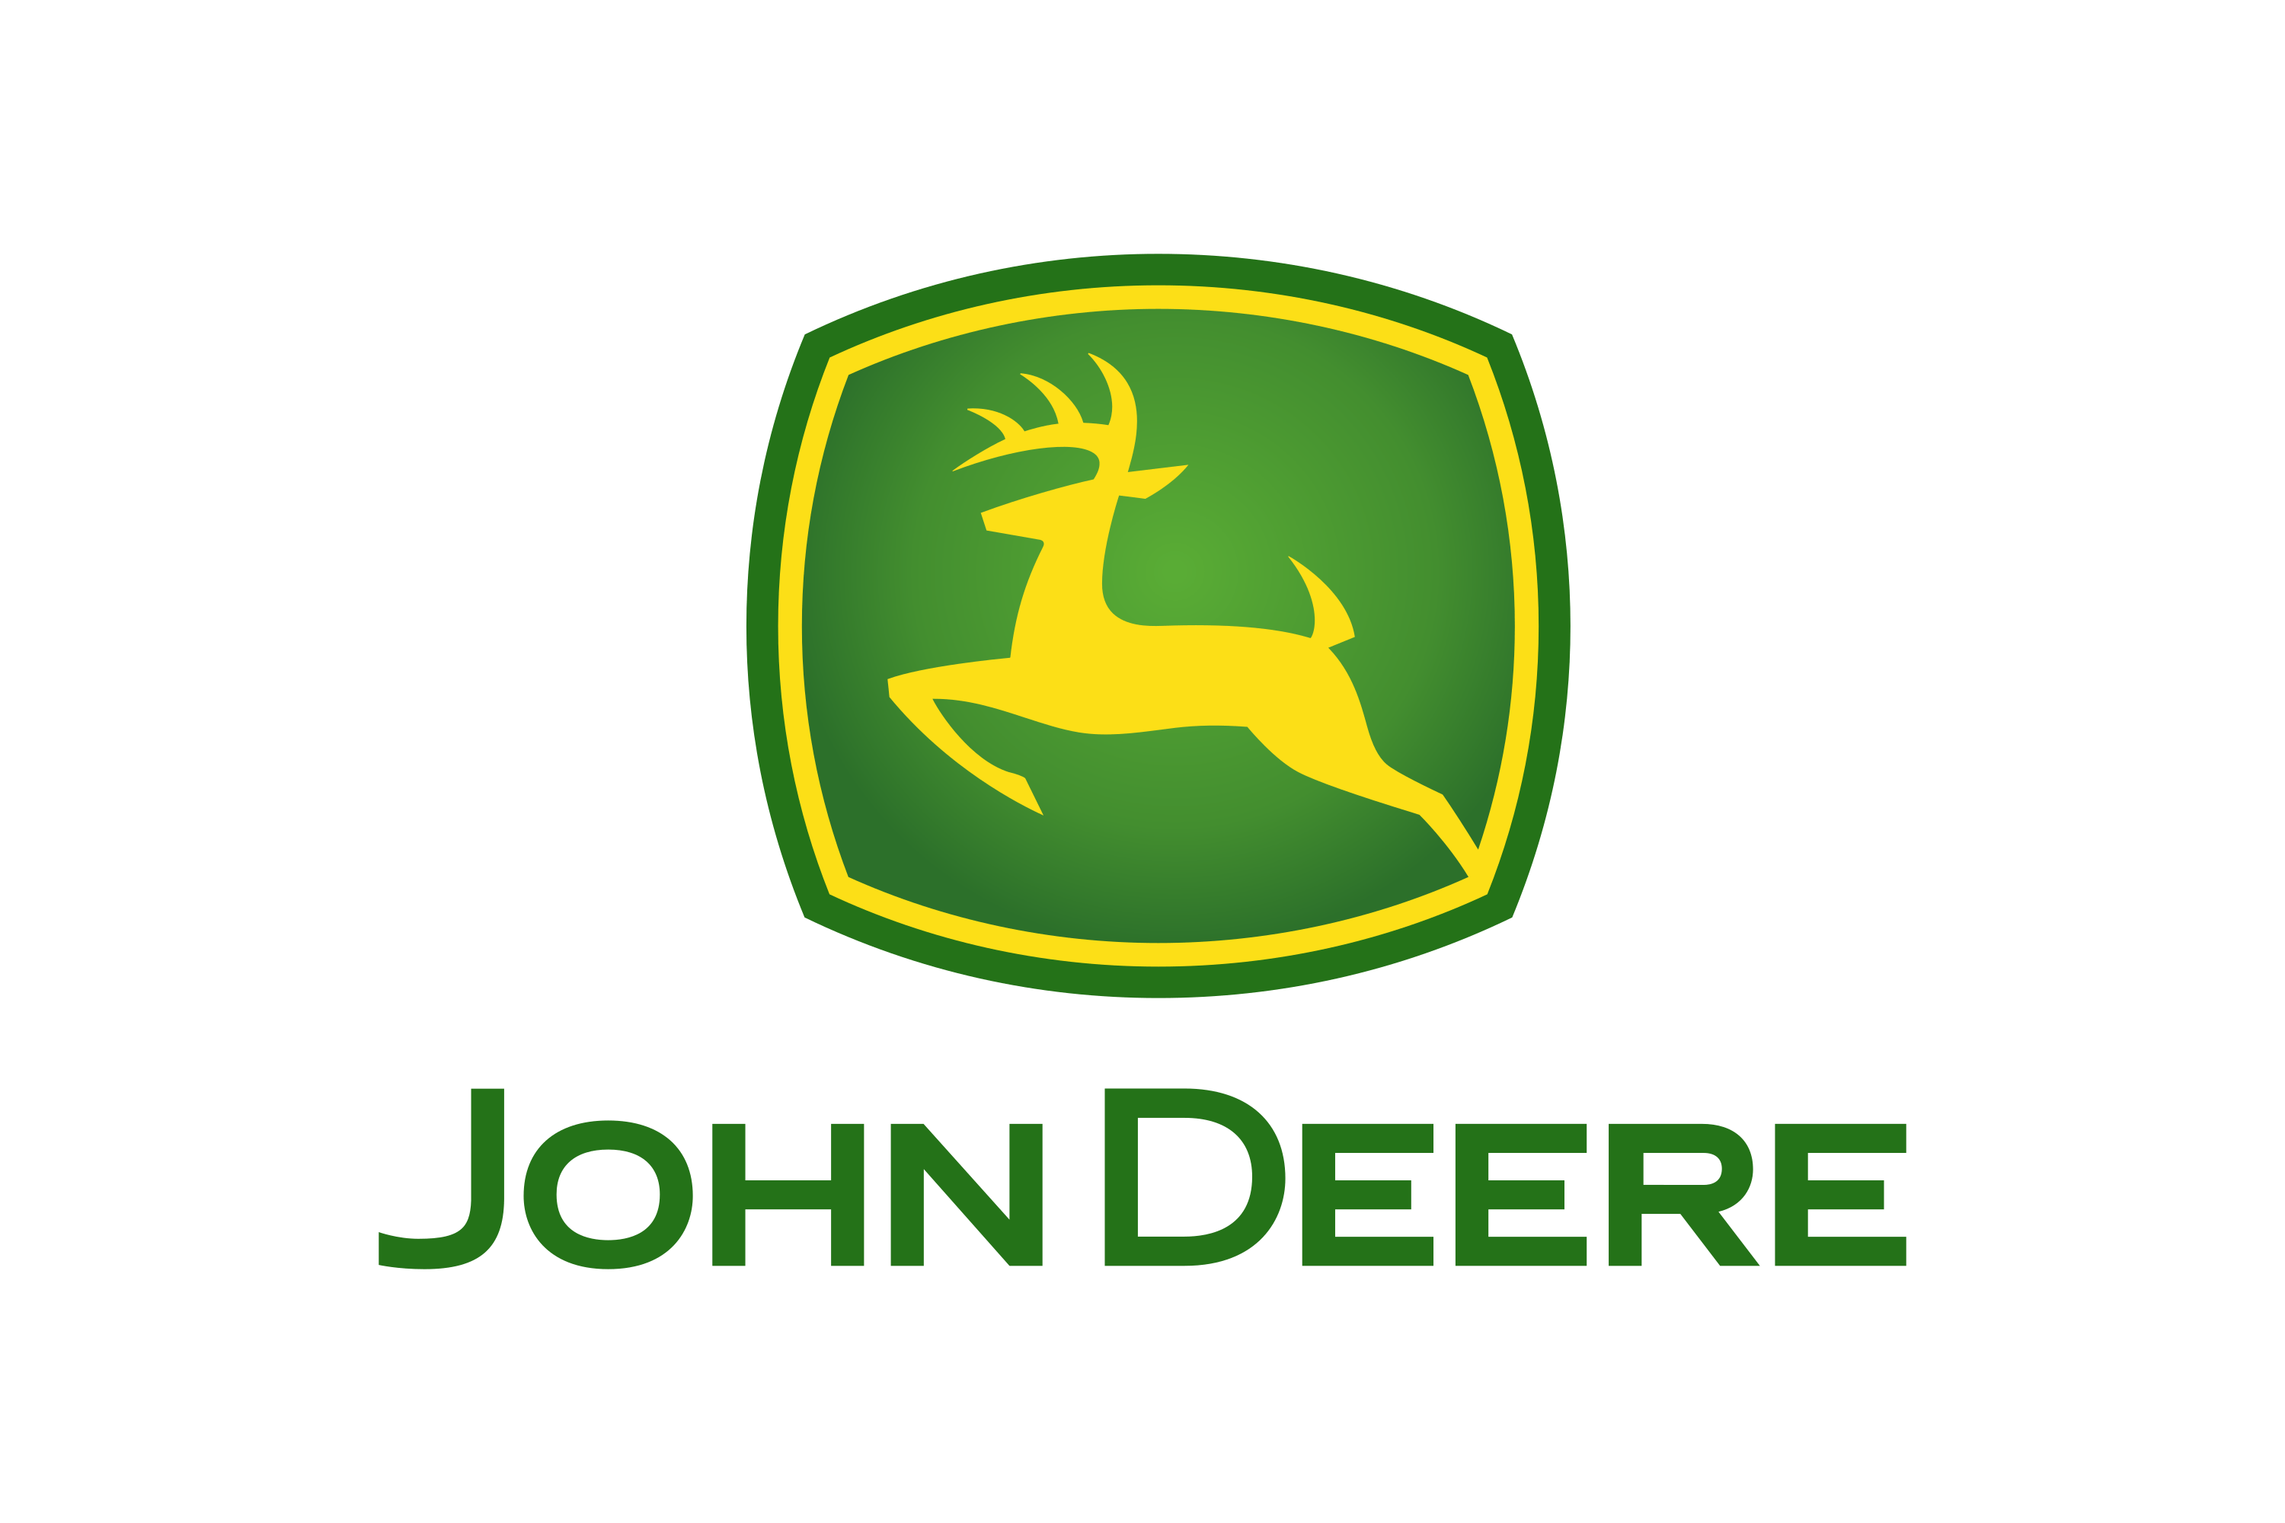






























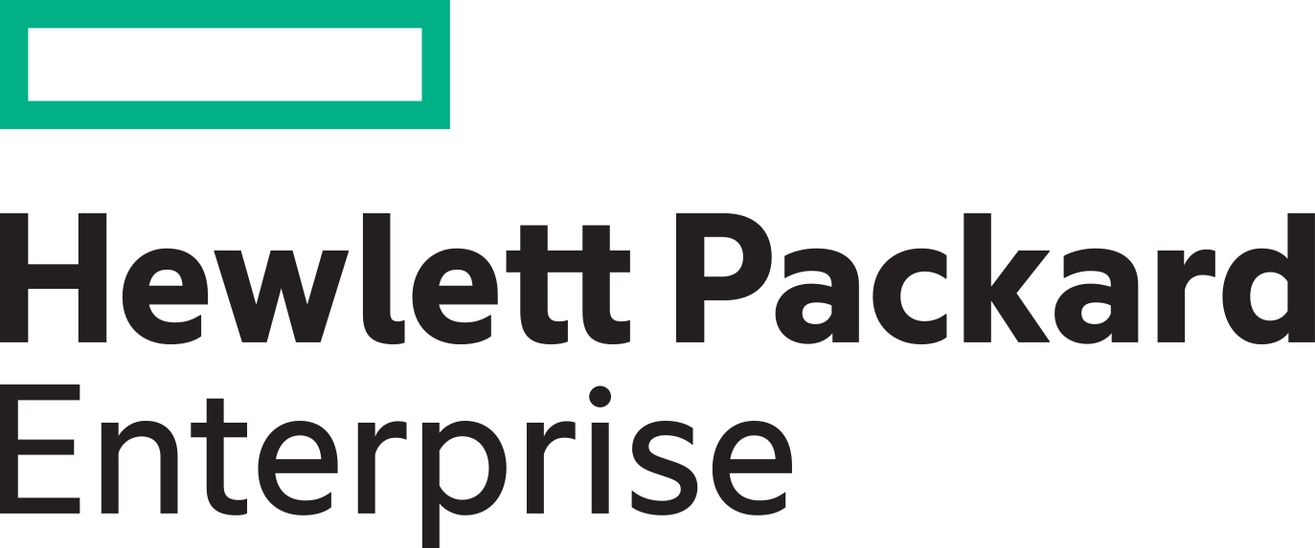













Azure Arc customers

Slide 55
Azure Arc pricing

Slide 56
Azure Arc pricing model
Control plane functionality:
Tagging, management groups, activity logs, templates, Resource Graph, RBAC
No additional cost
Customers’ servers and clusters

Slide 57

Azure Arc pricing model contd.
Azure Policy—guest configuration
Azure Monitor
Microsoft Defender for Cloud
Microsoft Sentinel
Backup
Log Analytics
GitOps management for Kubernetes Application Insights
Config and Change Management
Additional services ($)*
Azure Arc-enabled services ($)*
SQL Managed Instance (GA)
PostgreSQL (preview)
Azure Machine Learning (GA)
App Service, Functions, Logic Apps, APIM, Event Grid (preview)
No additional cost
Control plane functionality:
Tagging, management groups, activity logs, templates, Resource Graph, RBAC
Customers’ servers and clusters
*Pricing for Azure Arc-enabled services and additional management services is consistent with Azure pricing.
Services are available at no cost during preview.

Slide 58


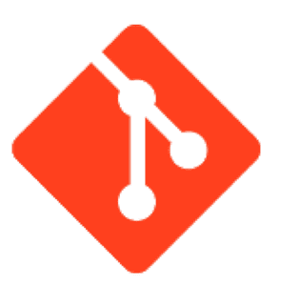
Azure Arc-enabled Kubernetes Pricing
Add-on Azure Management Services
Premium Capabilities: Azure Arc-enabled Kubernetes
Microsoft Defender for Cloud: Defender for Containers Free
Microsoft Defender for Containers is currently in preview, so there is no cost.
Azure Monitor & Log Analytics $2.30/GB [Pay as you go]
Billed for log analytics, tests, metrics, alerts, and notifications. 5GB per billing account/month is included.
Azure Policy for Kubernetes (Control-Plane) Free
There may be additional billing charges for data ingestion incurred through Azure Policies
Cluster Configuration with GitOps $2/vCPU/month
The first 6 vCPU’s are free.
Only pay once
Azure Policy for Kubernetes (Configuration) $2/vCPU/month
The first 6 vCPU’s are free.
*If the Arc-enabled Kubernetes cluster is on Azure Stack Edge, AKS on Azure Stack HCI (>=April 2021 update), or AKS on Windows Server 2019 Datacenter (>=April 2021 update), then the Kubernetes configuration is included at no charge. More information on this can be found on the docs page.

Slide 59

Azure Arc-enabled Servers Pricing
Add-on Azure Management Services
Premium Capabilities: Azure Arc-enabled servers
Microsoft Defender for Cloud ~$5/server/month (Plan 1) and ~$15/server/month (Plan 2)
Free for the first 30 days, with 500MB/server included data.
Azure Monitor & Log Analytics $2.30/GB [Pay as you go]
Billed for log analytics, tests, metrics, alerts, and notifications. 5GB per billing account/month is included.
Microsoft Defender $2/GB-ingested [Pay as you go]
Billed for the volume of data ingested for analysis in Microsft Defender, stored in the Azure Monitor Log Analytics workspace
Azure Policy Guest Configuration $6/server/month
Policies assigned by Defender for Cloud, of any other category, or on Stack HCI resources are exempt.
NEW Azure Policy offer – No charge for Arc-enabled Kubernetes from 10/01/22 - 10/01/2023
Only pay once
Azure Automation Configuration Management $6/server/month
Include Azure Automation change tracking, inventory, state configuration; Update Management is free.

Slide 60
Azure Arc-enabled SQL Server Pricing
Add-on Azure Management Services
Premium Capabilities: Azure Arc-enabled SQL Server
Microsoft Defender for Cloud: Defender for Arc-enabled SQL Server $15/instance/month
Microsoft Defender for SQL for non-Arc enabled, non-Azure instances costs $10.95/vCore/month.
Azure Monitor & Log Analytics $2.30/GB [Pay as you go]
Billed for log analytics, tests, metrics, alerts, and notifications. 5GB per billing account/month is included. The environmental health assessment does not incur additional costs outside of data ingestion.
Azure Policy for Arc-enabled SQL Server Free
There may be additional billing charges for data ingestion incurred through Azure Policies

Slide 61
New cloud billing model for SQL Server
Better cost efficiency when paying only for what you use
SQL Server pay-as-you-go licensing enabled by Azure Arc (per core per month/hour)
Flexible licensing options
Pricing | Monthly rate | Hourly rate
Standard Edition | $73 | $0.100
Enterprise Edition | $274 | $0.375
Choose from consumption-based licensing and perpetual SQL Server license
Cost efficiency
Pay by the hour for spikes and ad-hoc usage. No need for full upfront investment
Supports hybrid deployment
Consistent purchasing option across on-premise and in 3rd party cloud
Available on SQL Server 2014, 2016, 2017, 2019, and 2022

Slide 62
Azure Arc-enabled SQL Managed Instance Pricing
Consistent Cloud Billing Model with Azure
Pay-As-You-Go
1-year Reserved Instance
3-year Reserved Instance
General Purpose
$153
$113
$93
License included
General Purpose
Azure Hybrid Benefit*
$80
$40
$20
Business Critical
$434
$354
$314
License included
Business Critical
Azure Hybrid Benefit*
$160
$80
$40
Pricing based on 1vCore/month.
*Restrictions apply

Slide 63
Arc-enabled data services business model comparison
Azure Arc-enabled SQL Managed Instance
Azure Arc-enabled SQL Server* (pay-as-you-go)
Azure SQL
Azure add-on services**
Azure add-on services**
Azure add-on services**
SQL license
SQL license
SQL license
Azure SQL manageability
Azure SQL manageability (PaaS)
Azure SQL manageability (IaaS free)
Not provided by MSFT
Azure control plane (free)
Azure control plane via Azure Arc (free)
Azure control plane via Azure Arc (free)
Free
Additional cost
Azure infrastructure
Customer provided infrastructure
Customer provided infrastructure
Charged in the SKU
Azure/Arc SQL SKU
* SQL Server purchased via L+SA can also be Arc enabled with the same Azure database manageability
** Azure add-on services like MS Defender for Cloud or Azure Monitor is available with additional cost

Slide 64
Additional Information
Azure Monitor, Microsoft Sentinel, Guest Configuration Pricing

Slide 65

Azure Monitor Pricing
Azure Monitor: Commitment Tiers
Azure Log Analytics $2.30/GB [Pay as you go]
Billed by data ingestion, retention, and export
Azure Log Analytics Commitment Tiers
100 GB/day Tier $196/day
Effective Pricing of $1.96/GB | 15% Saving
500 GB/day Tier $865/day
Effective Pricing of $1.73/GB | 25% Saving
200 GB/day Tier $368/day
Effective Pricing of $1.84/GB | 20% Saving
1000 GB/day Tier $1700/day
Effective Pricing of $1.70/GB | 26% Saving
300 GB/day Tier $540/day
Effective Pricing of $1.80/GB | 22% Saving
2000 GB/day Tier $3320/day
Effective Pricing of $1.66/GB | 28% Saving
400 GB/day Tier $704/day
Effective Pricing of $1.76/GB | 23% Saving
5000 GB/day Tier $8050/day
Effective Pricing of $1.61/GB | 30% Saving

Slide 66
Microsoft Sentinel Pricing
Microsoft Sentinel: Commitment Tiers
Microsoft Sentinel $2/GB-ingested [Pay as you go]
Billed by data ingestion, retention, and export
Microsoft Sentinel Commitment Tiers
100 GB Tier $100/day
Effective Pricing of $1/GB | 50% Saving
500 GB Tier $400/day
Effective Pricing of $0.80/GB | 60% Saving
200 GB Tier $180/day
Effective Pricing of $0.90/GB | 55% Saving
1000 GB Tier $780/day
Effective Pricing of $0.78/GB | 61% Saving
300 GB Tier $260/day
Effective Pricing of $0.87/GB | 57% Saving
2000 GB Tier $1480/day
Effective Pricing of $0.74/GB | 63% Saving
400 GB Tier $334/day
Effective Pricing of $0.84/GB | 58% Saving
5000 GB Tier $3500/day
Effective Pricing of $0.70/GB | 65% Saving

Slide 67
Free
It is free to use most Azure Policies on Arc-enabled servers
Is Defender for Cloud deploying the policy?
Are you using Azure Automation on this machine?
Is the Azure Policy
the Azure Security Benchmark?
Is the policy
category
Guest Config?
Is the server hosted on Azure Stack HCI with
Arc Agent 1.13
or higher?
$6 / server per month
No
No
No
Yes
No
Yes
Yes
Yes
No
Yes

Slide 68
Azure Arc partner opportunity

Slide 69


Example: Azure Arc Partner Opportunity - Migration
Scenario: A customer has 100 VMs (Linux/Windows) running on-premises. The VMs consist of file servers, SQL instances, web servers and backend servers. You as a partner have been brought in to conduct an analysis of the infrastructure, execute the migration and implement a unified operations strategy using Azure native tools.
Azure Policy
Guest Config Policy+ Sentinel ACR $
50 x Azure Arc-enabled Servers + Azure Services
Migration
50 x Azure VMs + Sentinel
ACR $ generated
From the migration
+
Sentinel ACR $

Slide 70





Example: Azure Arc Partner Opportunity – App modernization, governance and compliance at-scale
Scenario: A customer has Kubernetes-based practice in both Azure and on-premises and is struggling with infrastructure sprawl and lack of operational consistency. You as a partner have been brought in to conduct an analysis of the infrastructure and the Kubernetes practice, and implement a unified operations strategy using Azure native tools.
Azure Policy
0$ ACR
Existing customer
DevOps practices
Azure Monitor
Azure Log Analytics
Microsoft Defender
Microsoft Sentinel
Azure Management & Operations practice
DevOps practice
Existing customer management and operations practices
Application modernization with containers
Customer applications
Customer CI/CD
Pipeline Management
No visibility, no unified operations practices
Role-based access control
with Azure Active Directory
No at-scale Kubernetes infrastructure governance
On-premises/other clouds
Kubernetes clusters
Azure Kubernetes Service

Slide 71





Example: Azure Arc Partner Opportunity – App modernization, governance and compliance at-scale
Scenario: A customer has Kubernetes-based practice in both Azure and on-premises and is struggling with infrastructure sprawl and lack of operational consistency. You as a partner have been brought in to conduct an analysis of the infrastructure and the Kubernetes practice and implement a unified operations strategy using Azure native tools.
Azure Policy
Azure Templates
Azure Audit
Azure Tags
Azure
Resource Graph
Azure Monitor
Azure Log Analytics
Microsoft Defender
Microsoft Sentinel
RBAC
GitOps
Configurations
Hybrid application modernization unified operations, DevOps, governance, compliance and security at-scale
Customer applications
Customer applications
On-premises/other clouds
Azure Arc-enabled Kubernetes clusters
Azure Kubernetes Service

Slide 72
Example: Azure Arc Partner Opportunity – App modernization, governance and compliance at-scale
Scenario: A customer has Kubernetes-based practice in both Azure and on-premises and is struggling with infrastructure sprawl and lack of operational consistency. You as a partner have been brought in to conduct an analysis of the infrastructure and the Kubernetes practice and implement a unified operations strategy using Azure native tools.
Azure Arc-enabled Kubernetes ACR $ + attached services ACR $
Azure Policy
Azure Templates
Azure Audit
Azure Tags
Azure
Resource Graph
No at-scale Kubernetes infrastructure governance
No visibility, no unified operations practices
Azure Monitor
Azure Log Analytics
Microsoft Defender
Microsoft Sentinel
RBAC
GitOps
Configurations
Hybrid application modernization unified operations, DevOps, governance, compliance and security at-scale
Customer applications
Customer applications
On-premises/other clouds
Azure Arc-enabled Kubernetes clusters
Azure Kubernetes Service

Slide 73
Azure Arc programs and resources

Slide 74
Hybrid and multicloud with Azure Arc (Available in field and partner-led AMMP)
New AMMP offers and support so you can innovate anywhere
NEW!
Assess & Plan
Migrate & Modernize
Arc Envisioning Workshop ^{NEW OFFER}
Overview of Azure Arc capabilities
Get hands-on experience with Azure Arc onboarding suited to your scenario (e.g. VMs, Azure SQL Managed Instance or a Kubernetes cluster).
Understand management scenarios, including security with Microsoft Defender for Cloud
Pilot/Proof of Concept
AMMP’s pilot/POC offering extended to support all Arc-enabled scenarios
Up to $20K partner funding + up to $5K Azure Access sandbox
Standard and Advanced offers ^{EXPANDED SUPPORT}
Azure Arc supported in both Infrastructure/Database Migration and App & Data Modernization scenarios
AMMP benefits are aligned to Standard and Advanced offers:
  Assistance from partners + FastTrack for Azure guidance in Advanced offer
  Partner funding at 20% of 1st year Azure consumption estimates
  Azure credits (up to $5K for Standard, up to $100K for Advanced)
  Technical skilling
Guidance – include the Arc-enabled services in the overall project estimate
An example
Azure services | 1st year Azure consumption estimate | AMMP Partner funding
Azure VMs and data services | $800K | $160K
Arc-enabled infrastructure and services | $100K | $20K
Total | $900K | $180K
Azure services in scope: Azure Arc-enabled Virtual Machines (Windows and Linux), Azure Arc-enabled SQL Managed Instance/SQL Server, Azure Arc-enabled Kubernetes

Slide 75






Plan
Complete guidance for hybrid and multicloud approach
Govern
Manage
Define
Strategy
Adopt
Ready
Build skills across
your team with
Microsoft Learn
Accelerate deployment with Reference Architectures
Optimize workloads with Azure
Well-Architected
Apply best
practices to
rapidly onboard
Review technical documentation on featured products
Cloud Adoption Framework
Guide your cloud journey across people, process and technology
Start with the cloud adoption framework to guide your cloud journey
and build on it using the hybrid adoption scenario guidance
https://aka.ms/ArcLZAcceleratorReady

Slide 76
Resources
  Azure Arc webpage
  aka.ms/Arc
  Technical docs
  aka.ms/ArcDocs
  Azure Arc Learn modules
  aka.ms/LearnHybridArc
  Azure Arc Jumpstart
  aka.ms/AzureArcJumpstart
  Azure Arc Roadmap
  aka.ms/ArcRoadmap

Slide 77


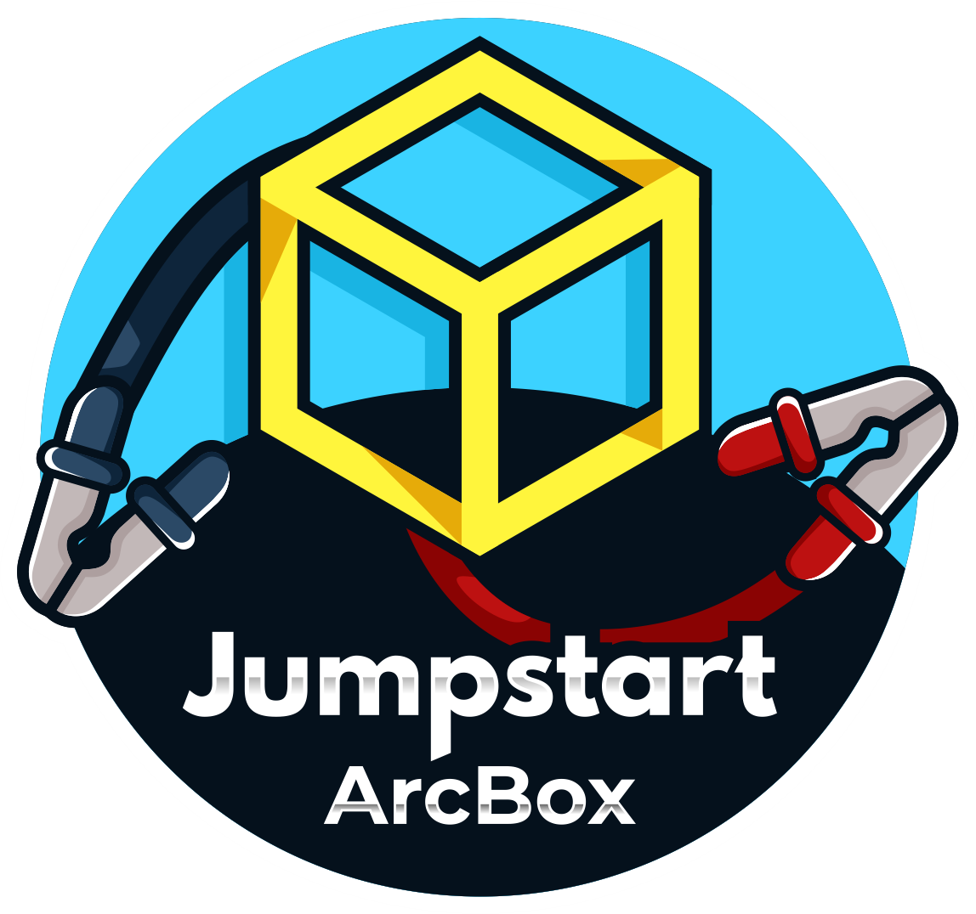
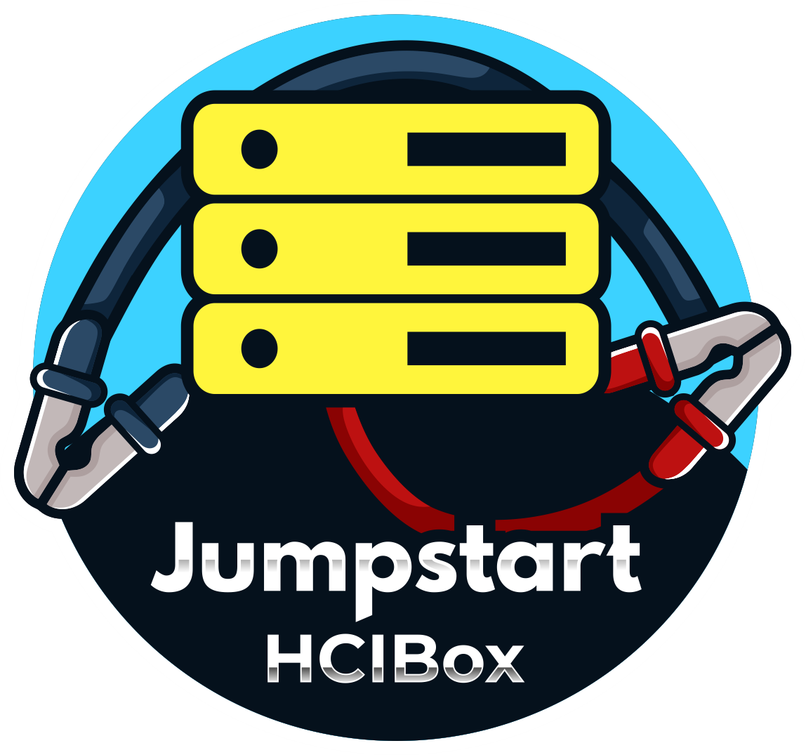
Azure Arc Jumpstart
Rich, automated, open-sourced, community-driven
aka.ms/AzureArcJumpstart

Slide 78
Thank you!

